Slide 1

Lesson 13:Reflection API, Annotations

Slide 2
Reflection API
The ability to examine or modify the runtime behavior of applications
read properties
update data
change model
get the metadata of a class at run time
examine and change the run time behavior of a class

Slide 3
Class obtaining
forName() method of Class class
Class clazz = Class.forName(“org.geekhub.App");
getClass() method of Object class
Class clazz = instance.getClass();
the .class syntax
Class clazz = App.class
By classloader

Slide 4
Class loader
Class loaders are responsible for loading Java classes dynamically to the JVM (Java Virtual Machine) during runtime. They're also part of the JRE (Java Runtime Environment). Therefore, the JVM doesn't need to know about the underlying files or file systems in order to run Java programs thanks to class loaders.
Furthermore, these Java classes aren't loaded into memory all at once, but rather when they're required by an application. This is where class loaders come into the picture. They're responsible for loading classes into memory.
In this tutorial, we'll talk about different types of built-in class loaders and how they work. Then we'll introduce our own custom implementation.

Slide 5
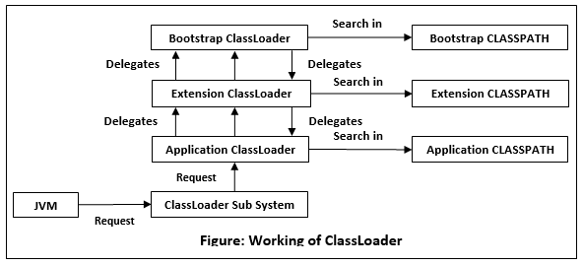
Class loader

Slide 6
Class loader
public void printClassLoaders() throws ClassNotFoundException { System.out.println("Classloader of this class:" + PrintClassLoader.class.getClassLoader()); System.out.println("Classloader of Logging:" + Logging.class.getClassLoader());
System.out.println("Classloader of ArrayList:" + ArrayList.class.getClassLoader());
}
Class loader of this class:sun.misc.Launcher$AppClassLoader@18b4aac2
Class loader of Logging:sun.misc.Launcher$ExtClassLoader@3caeaf62
Class loader of ArrayList:null

Slide 7
Class loader
The application class loader loads the class where the example method is contained. An application or system class loader loads our own files in the classpath.
Next, the extension class loader loads the Logging class. Extension class loaders load classes that are an extension of the standard core Java classes.
Finally, the bootstrap class loader loads the ArrayList class. A bootstrap or primordial class loader is the parent of all the others.
However, we can see that for the ArrayList, it displays null in the output. This is because the bootstrap class loader is written in native code, not Java, so it doesn't show up as a Java class. As a result, the behavior of the bootstrap class loader will differ across JVMs.

Slide 8
Class loader
Class loaders are part of the Java Runtime Environment. When the JVM requests a class, the class loader tries to locate the class and load the class definition into the runtime using the fully qualified class name.
The java.lang.ClassLoader.loadClass() method is responsible for loading the class definition into runtime. It tries to load the class based on a fully qualified name.
If the class isn't already loaded, it delegates the request to the parent class loader. This process happens recursively.
Eventually, if the parent class loader doesn’t find the class, then the child class will call the java.net.URLClassLoader.findClass() method to look for classes in the file system itself
If the last child class loader isn't able to load the class either, it throws java.lang.NoClassDefFoundError or java.lang.ClassNotFoundException.

Slide 9
Class instantiation
try {
Class<App> clazz = App.class;
App app = clazz.getConstructor().newInstance(); //requires no-args constructor log(app.getName()); } catch (InstantiationException | IllegalAccessException e) { log("Can not instantiate App by reflection: {}“, e.getMessage()); }

Slide 10
Class instantiation
try { Class[] argTypes = {
int.class, String.class, String.class
}; Constructor<App> constructor = clazz.getConstructor(argTypes); App app = constructor.newInstance(1, “App", "Some App desc"); log(app); //App{id=1, name=‘App’, description=‘Some App desc’} } catch (Exception e) { log("Error: {}", e.getMessage()); }

Slide 11
Declared fields
includes public, protected, default (package) access, and private fields, but excludes inherited fields
Class<App> clazz = App.class; Field[] declaredFields = clazz.getDeclaredFields(); for (Field field : declaredFields) { log("\t" + field); }

Slide 12
Fields
includes all the public fields up the entire class hierarchy
Class<App> clazz = App.class; Field[] fields = clazz.getFields(); for (Field field : fields) { log("\t" + field); }

Slide 13
Declared methods
includes public, protected, default (package) access, and private methods, but excluding inherited methods
Class<App> clazz = App.class; Method[] declaredMethods = clazz.getDeclaredMethods(); for (Method method : declaredMethods) { log("\t" + method); }

Slide 14
Invisible field update
Class<User> userClass = User.class; User user = new User(1, "John", 20, "UTF"); log(user.name); // John try { Field nameField = userClass.getDeclaredField("name"); nameField.setAccessible(true); nameField.set(user, "Roberto"); log(user.name); // Roberto } catch (NoSuchFieldException | IllegalAccessException e) { log("Error: {}“, e.getMessage()); }

Slide 15
Invisible field update
Class<User> userClass = User.class; User user = new User(1, "John", 20, "UTF");
log(user.name); // John try { Method setter = userClass.getDeclaredMethod("setName", String.class); nameSetter.setAccessible(true); nameSetter.invoke(user, "Roberto"); log(user.name); // Roberto } catch (NoSuchMethodException | IllegalAccessException | InvocationTargetException e) { log("Error: {}“, e.getMessage()); }

Slide 16
Annotations
@Deprecated
@Override
@SuppressWarnings
@FunctionalInterface
@NonNull
…

Slide 17
Annotations. RetentionPolicy
Retention Policy | Description
RetentionPolicy.RUNTIME | Signals to the Java compiler and JVM that the annotation should be available via reflection at runtime
RetentionPolicy.CLASS | Annotation is stored in the .class file, but not available at runtime. This is the default retention policy
RetentionPolicy.SOURCE | Annotation is only available in the source code, and not in the .class files and not a runtime. If you create your own annotations for use with build tools that scan the code, you can use this retention policy.

Slide 18
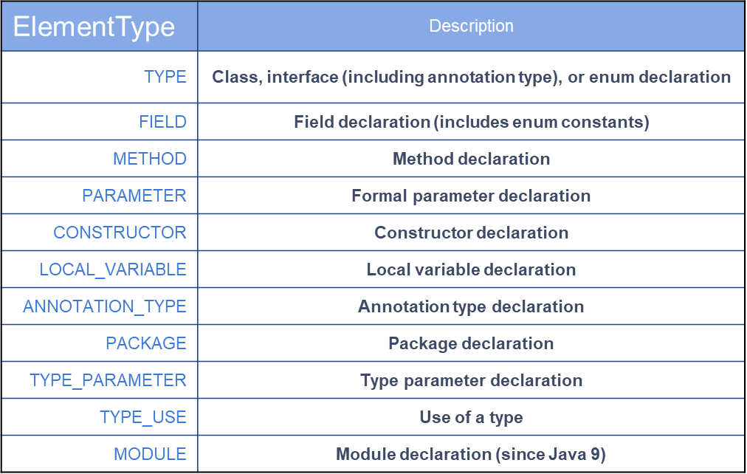
Annotations. ElementType

Slide 19
Annotations
@Target(value = ElementType.METHOD) @Retention(value = RetentionPolicy.RUNTIME) public @interface Version { int min(); int max(); String description() default ""; }

Slide 20
Annotations
class ApiClass { @Version // required attributes are missed void api0(){}
@Deprecated @Version(min = 1, max = 2) void api1(){}
@Version(min = 2, max = 3, description = “Some description") void api2(){} } @Version // wrong target element type class ApiClass2 {}

Slide 21
HomeWork
Create new annotation ' Injectable ' that can be applied to only to the fields. This annotation has field with name of property in property file, if name not specified you should use an exact name of field.
If no property found in property file, do not set any value and throw exception.
At the beginning of the program start, load all the values ​​from the properties file and set it to the fields marked with the 'Injectable' annotation based on field name

Slide 22
Thanks!
Find us in Slack:
@Bohdan Cherniak
@Vladyslav Nikolenko
@Volodymyr Vedula

